Slide 1
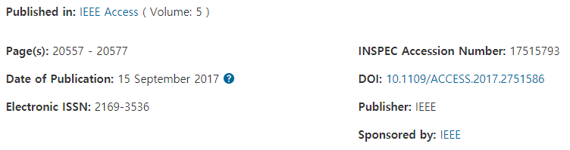
Narrow Band Internet of Things
NB-IoT
Min Chen, Senior Member, IEEE, Yiming Miao,
Yixue Hao, Student Member, IEEE, Kai Hwang, Life Fellow, IEEE
Sep. 17, 2018
PU3 R&D team

Slide 2
Low-Power Wide-Area Network (LPWAN) industry
LPWAN technologies classified into two categories
Unauthorized spectrum : Lora, Sigfox
Authorized spectrum : 2G/3G cellular communication(GSM, CDMA, WCDMA), LTE
Developed by international standards organizations such as 3GPP (GSM, WCDMA, LTE and evolved LTE technology, etc.) and 3GPP2 (CDMA, etc.)
NB-IoT is proposed by 3GPP, Since 2005 they research cellular network for Machine-Type Communication (MTC) services.
software upgrading and core network reusing deployed in authorized frequency bands
3GPP set 5 objectives for MTC(Machine-Type Communication)
Enhanced indoor coverage,
Supported massive small-data terminals,
Lower terminal complexity and cost,
Higher energy efficiency
Supported various latency features
Also define 3 new narrow band air interfaces, GSM-compatible EC-GSM-IoT, LTE-compatible eMTC(enhanced Machine Type Communication) and brand new NB-IoT technology.
NB-IoT is led by Huawei Technologies Co. Ltd

Slide 3
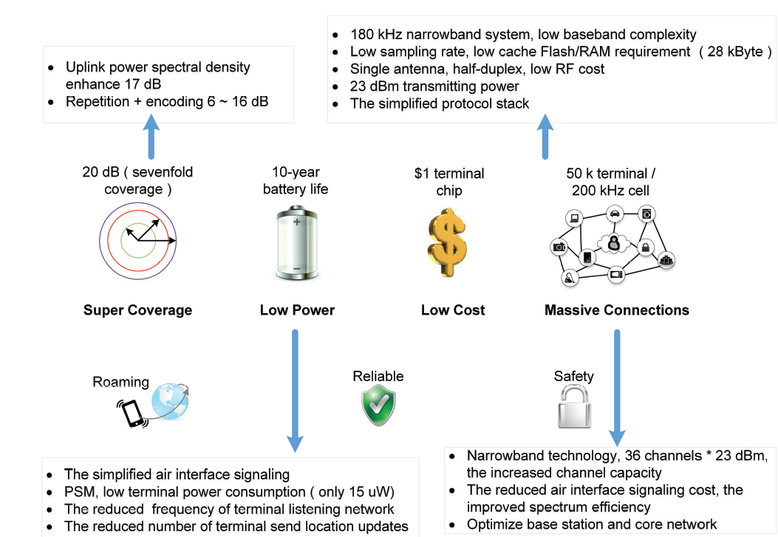
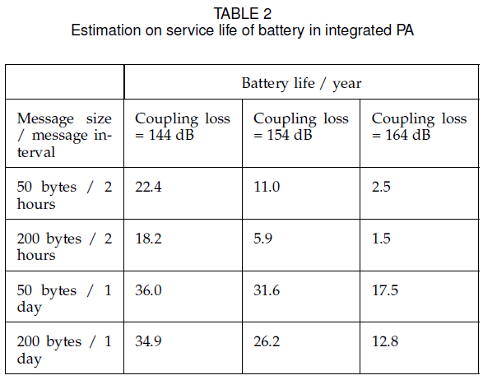
NB-IoT Features
5-Wh battery
전류소모 : normal operation → 644uA

Slide 4
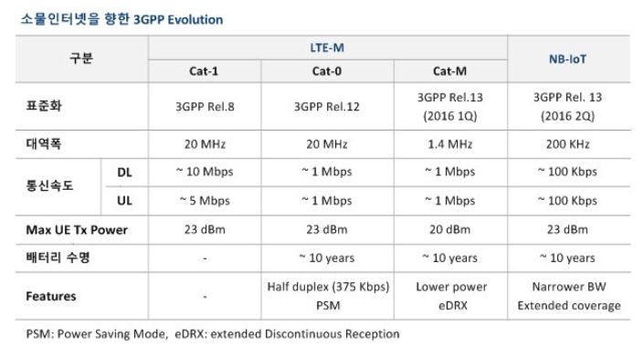
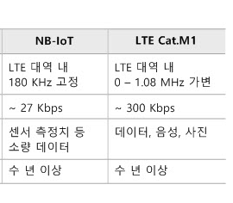
Comparison between NB-IoT and LTE eMTC
http://blog.naver.com/PostView.nhn?blogId=ktec21&logNo=220985245703

Slide 5
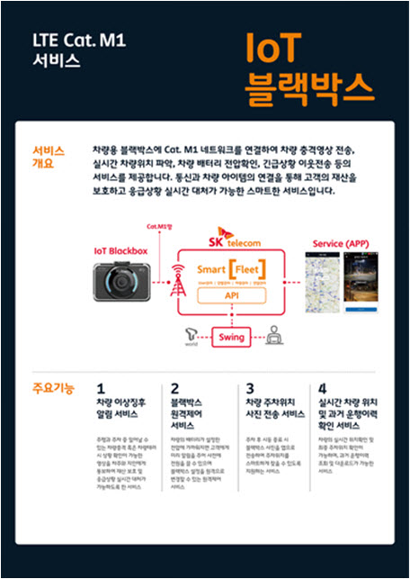
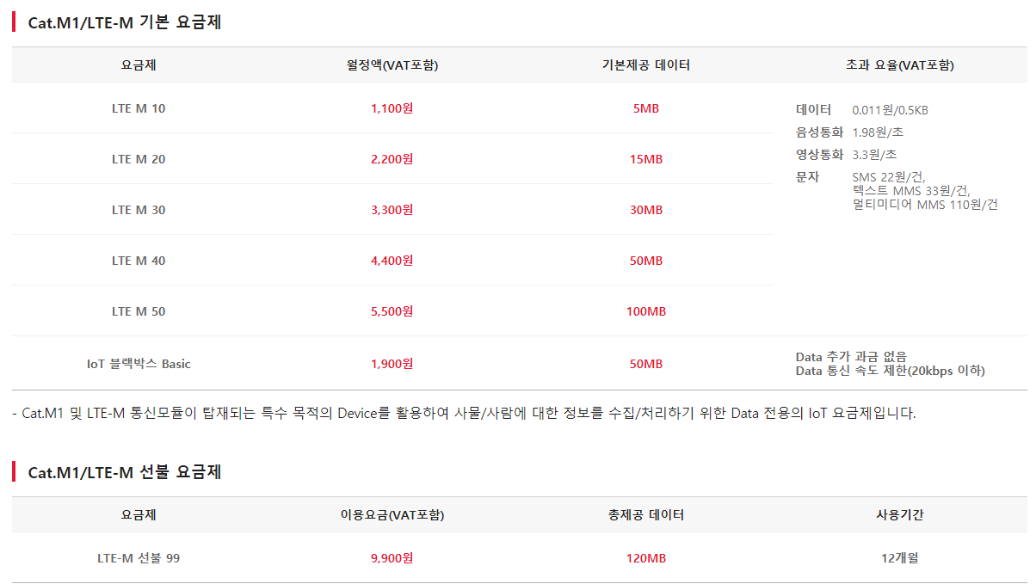
SK텔레콤, IoT 전국망 'LTE Cat.M1' 상용화
https://netmanias.com/ko/?m=view&id=operator_news&no=13540

Slide 6
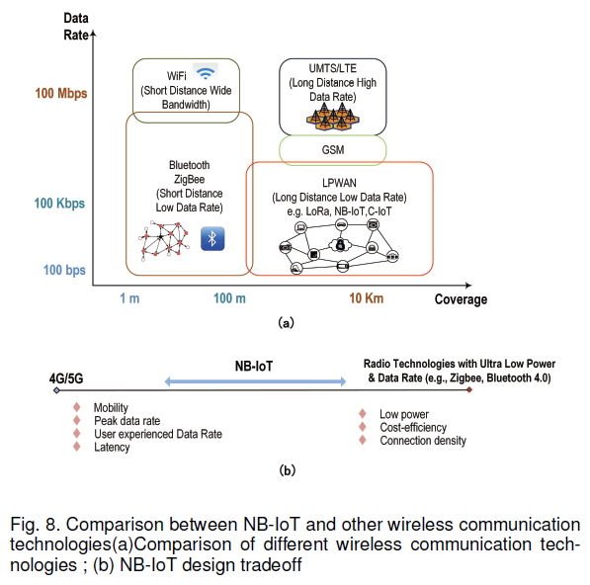
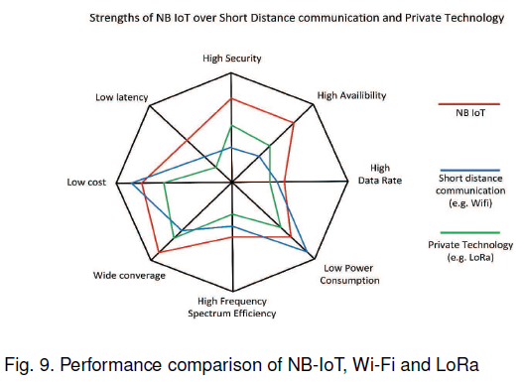
Comparison between NB-IoT and other wireless communication technologies

Slide 7
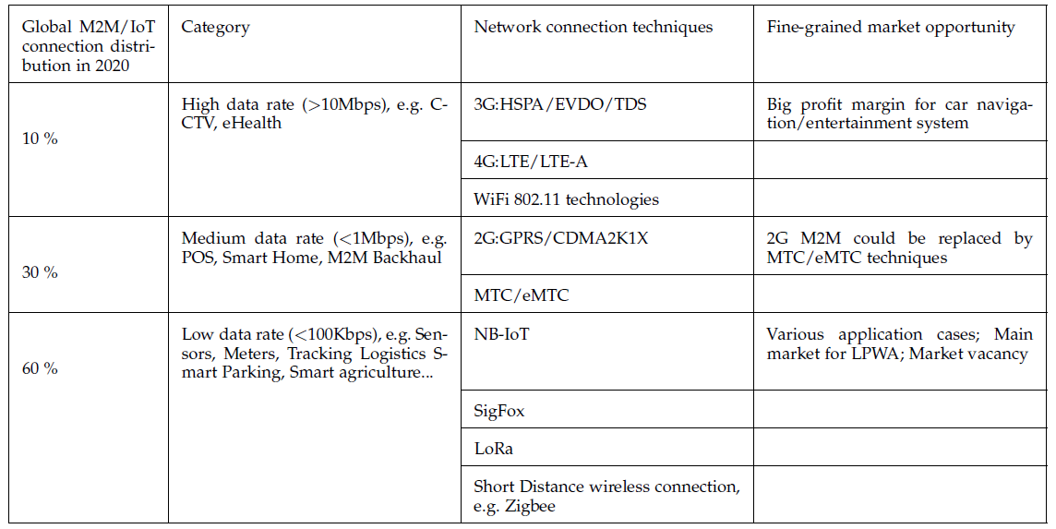
Distribution figure for connection technology of intelligent IoT in 2020

Slide 8
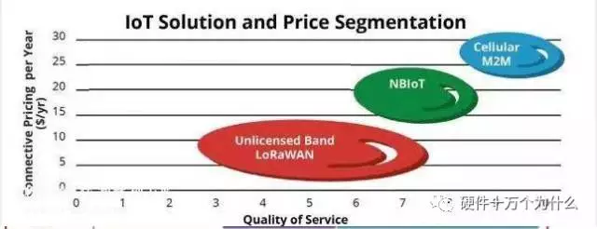
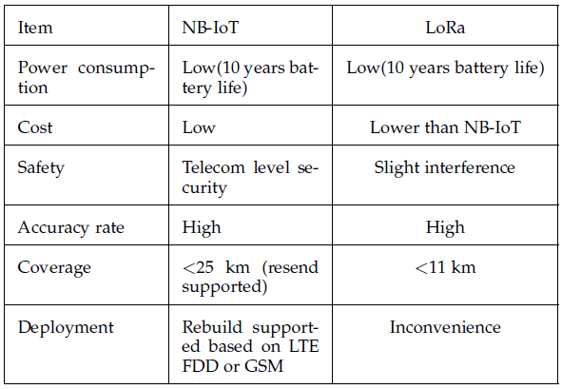
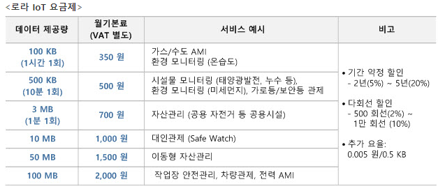
Comparison between NB-IoT and LoRa
사업자 | KT & LG Uplus | SK telecom
통신 속도 | 150Kbps | 10Kbps
이용 통신망 | 기존 LTE망 | 비면허 주파수
월 가격 | 825원 / 8MB | 350원 / 100KB

Slide 9
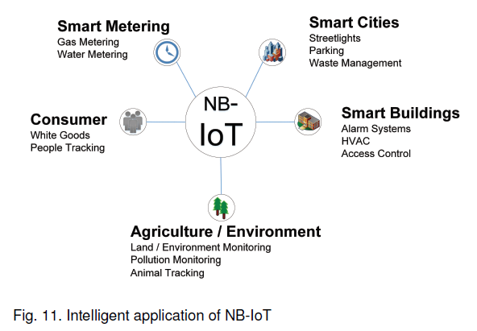
Intelligent application of NB-IoT

Slide 10
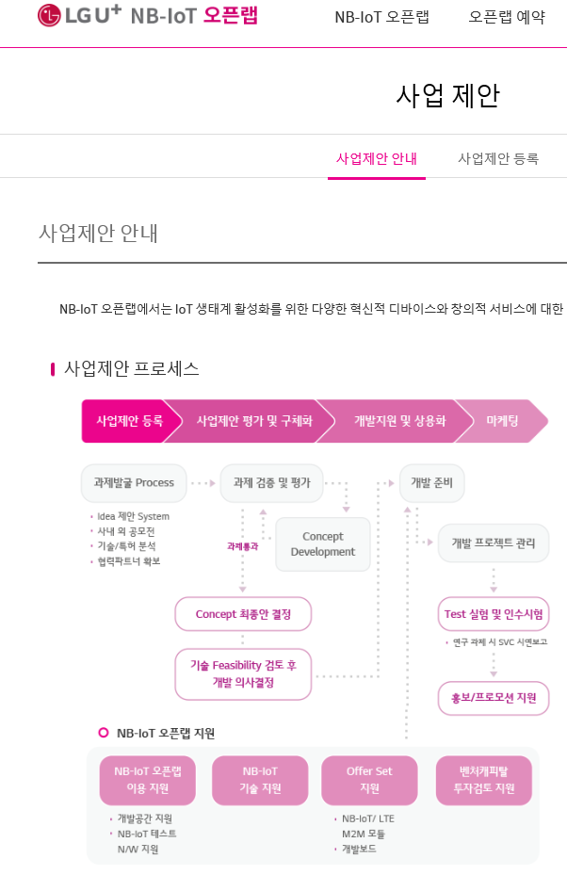
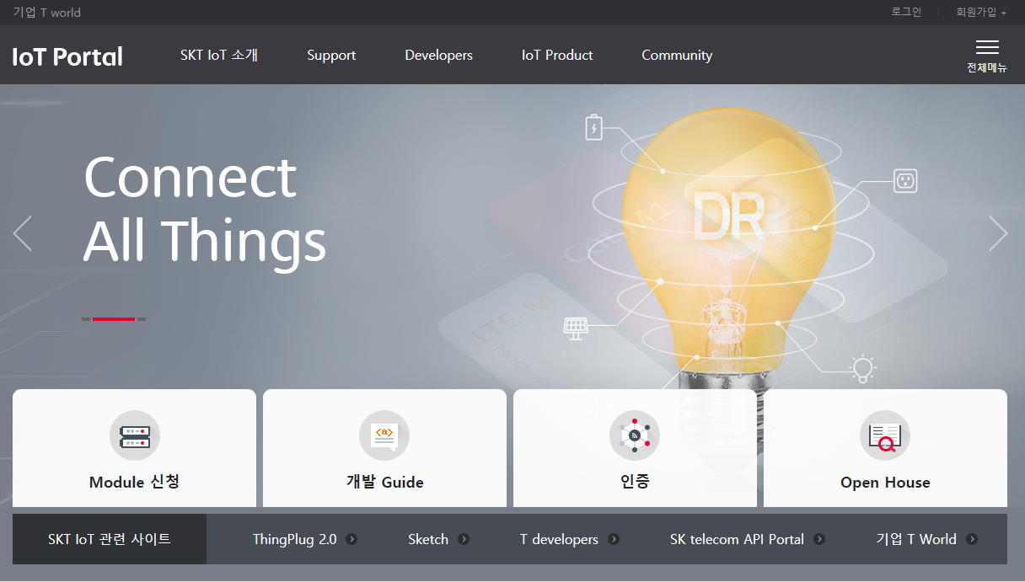
LPWAN in Korea
https://www.sktiot.com/iot/main/index
https://openlab.uplus.co.kr/lte/main/main.dev

Slide 11
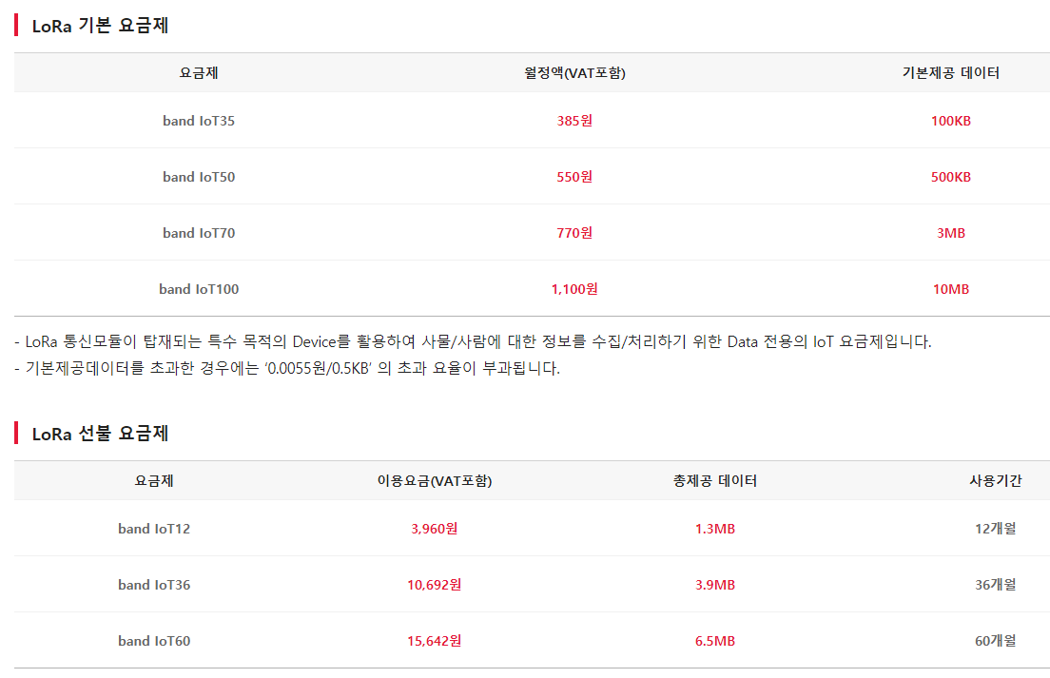
SKT IoT요금제

